Slide 1


Slide 2

Brief Introduction
Tanuj Nigam is a data scientist with 5+ years of professional experience in the area of data science. He is well versed with advance analytics tools and technologies including Deep learning, Blockchain, MLOPS etc. Apart from his work he is a visiting faculty at multiple data science institutes. His current interest includes use of AI/ML to build Quants based model for stock markets.
Linkedin : https://www.linkedin.com/in/tanuj-nigam-a4748375/

Slide 3
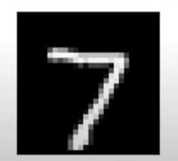
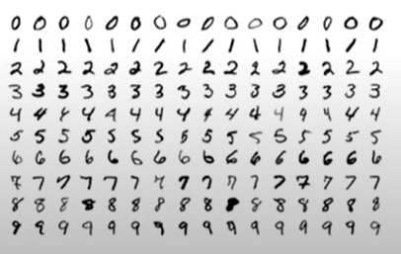
What are Generative Models ?
Training Data
Training
Generative Model
Sampling
Generated Sample
Noise

Slide 4
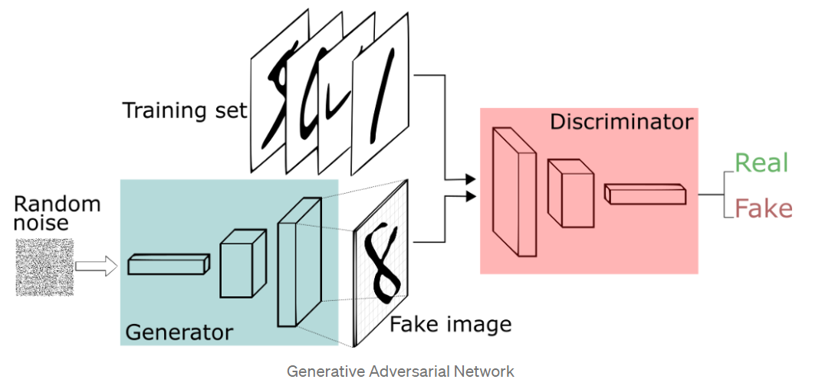
What are GAN’s ?
Discriminator
Discriminator network deciders whether the data is generated or taken from the real sample using a binary classification problem with the help of a sigmoid function that gives the output in the range 0 to 1
Generator
Generator network that takes a sample and generate a sample of data

Slide 5
What are GAN’s ?
Training Data
Real Sample
Discriminator Network
Real or Fake
Random Noise
Generator Network
Generated Sample

Slide 6
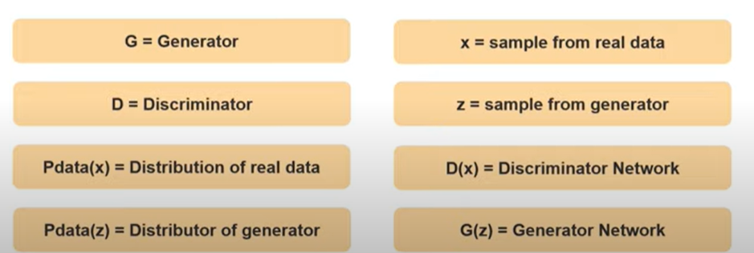
How does a GAN’s work ?

Slide 7
How to Train GAN’s
Real Sample
Train the discriminator and freeze the generator, which means the training set for the generator is turned as False and the network will only do the forward pass and no back-propagation will be applied
Discriminator Network
Sigmoid Function
Random Noise
Generator Network
Generated Sample

Slide 8
How to Train GAN’s
Train the generator and freeze the discriminator. In this phase, we get the results from the first phase and can use them to make better from the previous state to try and fool the discriminator better
Discriminator Network
Sigmoid Function
Generator Network
Generated Sample

Slide 9
Steps to train GAN
Define the Problem
1
2
Choose Architecture of GAN
Train Discriminator on Real Data
3
4
Generate Fake Inputs Generator
Train Discriminator on Fake
Data
5
6
Train Generator with the Output of Discriminator

Slide 10
Challenges Faced by GAN’s
GANs are more unstable to train because you have to train two networks from a single backpropagation. Therefore choosing the right objectives can make a big difference.
We cannot perform any inference queries with GANs
Problem to determine positioning of the objects

Slide 11
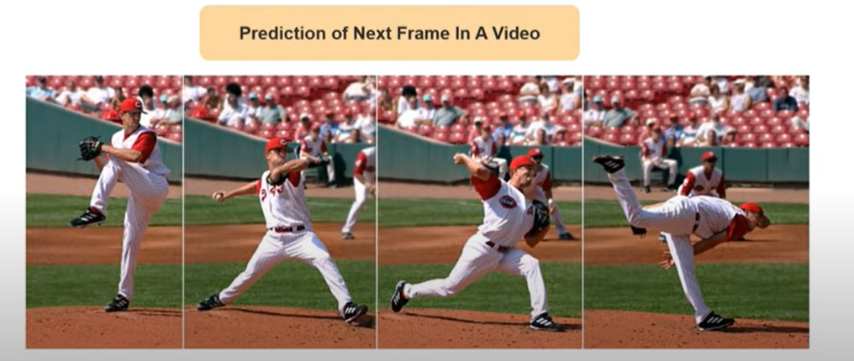
Application of GAN

Slide 12
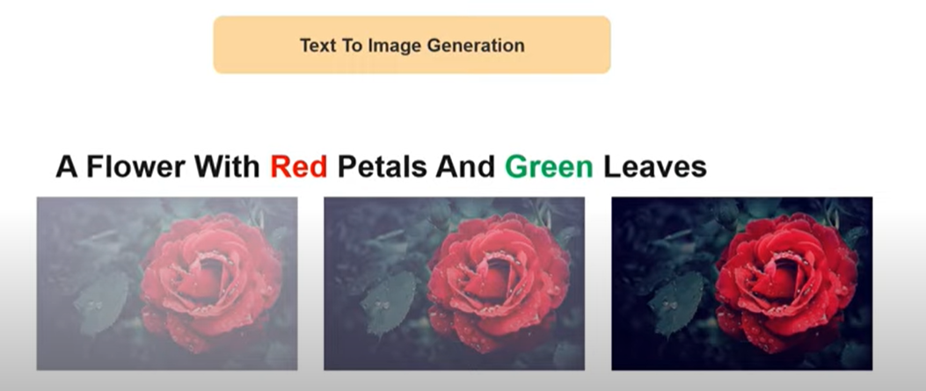
Application of GAN

Slide 13
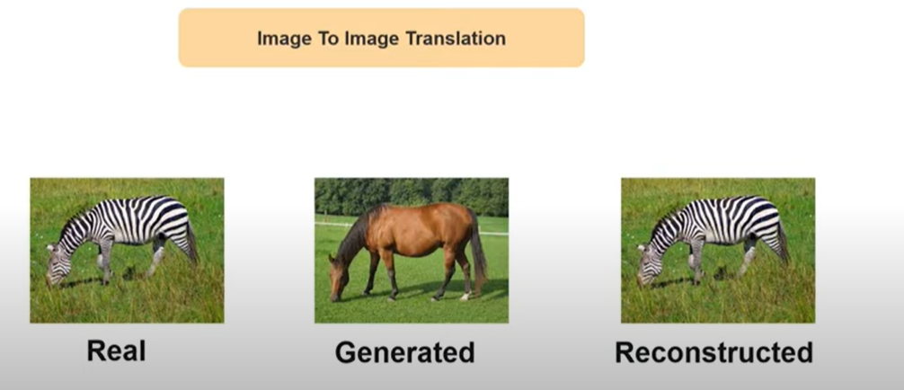
Application of GAN

Slide 14

Application of GAN

